Slide 1
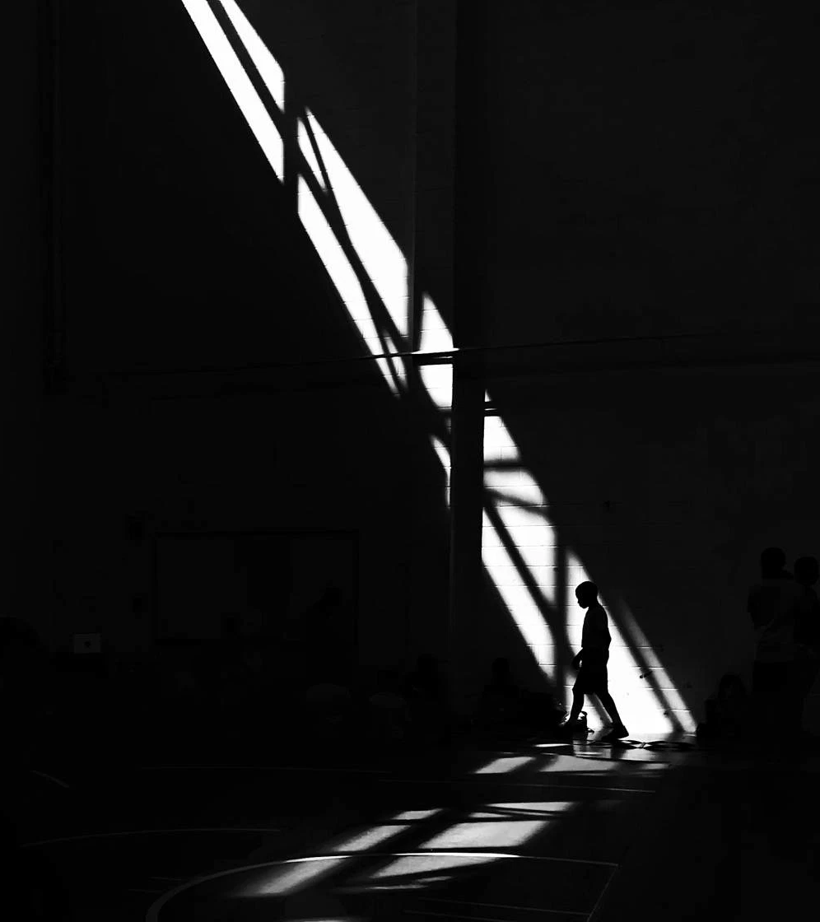

“A SINGLE BACKLIT IMAGE ENHANCEMENT METHOD FOR IMPROVEMENT OF VISIBILITY OF DARK PART”
by Masato Akai et al. (Published: IEEE ICIP, 2021)
Aniket Das (CS2407)
&
Soham Chakraborty (CS2432)
Course: Image Processing - I
Instructor: Pradipta Majhi
Indian Statistical Institute, Kolkata

Slide 2

Introduction : Backlit Image
An image where the primary light source is behind the subject, causing the foreground to appear dark or silhouetted.
Challenges:
Loss of detail in shadows and highlights
Poor contrast in key subject areas
Glare or halo effects around object edges
Difficulty in segmentation and object detection
Image Processing - I
Indian Statistical Institute, Kolkata
2

Slide 3
Objective of the Paper
Propose a simple and fast method for enhancing backlit images
Improve visibility in dark regions without introducing artifacts
Avoid over-enhancement and color distortion common in other methods
Develop an approach for real-time applications and low-resource devices
Image Processing - I
Indian Statistical Institute, Kolkata
3

Slide 4
Proposed Method
Generation of enhanced intensity image using Gamma Correction and Histogram Equalization
Generation of weight map using Otsu’s Thresholding and creating a guided weight filter
Image composition using the filtered weight map
Image Processing - I
Indian Statistical Institute, Kolkata
4

Slide 5
Flowchart
Otsu’s Method
I
W
Guided Filter
W̃
Gamma Correction
I^{gamma}
α-blending
O
Image Composition using filtered weight map
Õ
Histogram Equalization
I^{HE}
Image Processing - I
Indian Statistical Institute, Kolkata
5

Slide 6
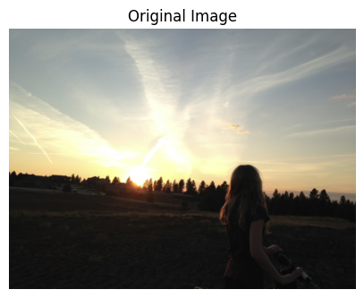
Proposed Method : Implementation
Original image
Image Processing - I
Indian Statistical Institute, Kolkata
6

Slide 7
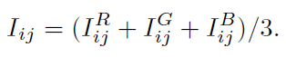
Proposed Method : Implementation
Let I_{ij}^{RGB} be a pixel value of an input 24-bit RGB color backlit image.
The intensity image is first computed using the mean of all components (red, green, blue) for a particular pixel:
Image Processing - I
Indian Statistical Institute, Kolkata
7

Slide 8
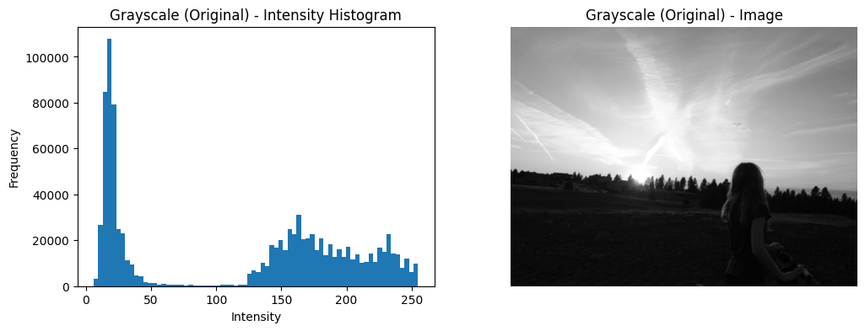
Proposed Method : Implementation
Histogram of the image
Grayscale intensity image I
Image Processing - I
Indian Statistical Institute, Kolkata
8

Slide 9
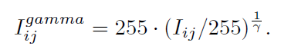
Proposed Method : Implementation
Gamma Correction : To improve the visibility of the image, gamma correction is applied to I_{ij} (γ = 2).
Histogram Equalization : The contrast is further improved using histogram equalization.
Image Processing - I
Indian Statistical Institute, Kolkata
9

Slide 10
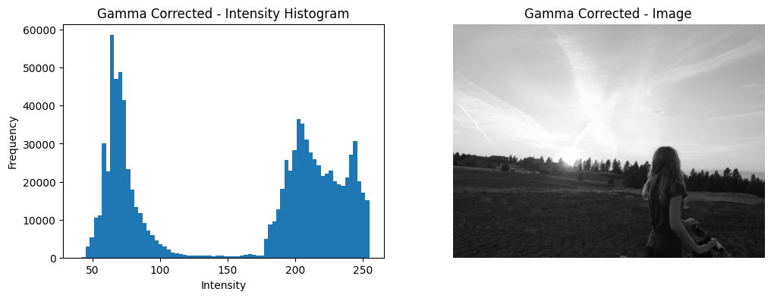
Proposed Method : Implementation
Histogram of the image
Result of gamma correction for I
Image Processing - I
Indian Statistical Institute, Kolkata
10

Slide 11
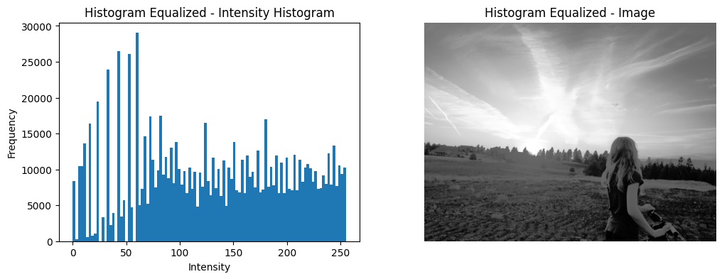
Proposed Method : Implementation
Histogram of the image
Result of histogram equalization for I
Image Processing - I
Indian Statistical Institute, Kolkata
11

Slide 12
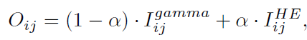
Proposed Method : Implementation
Alpha Blending : The pixel values of an enhanced intensity image O is calculated as follows (α = 0.7):
Image Processing - I
Indian Statistical Institute, Kolkata
12

Slide 13
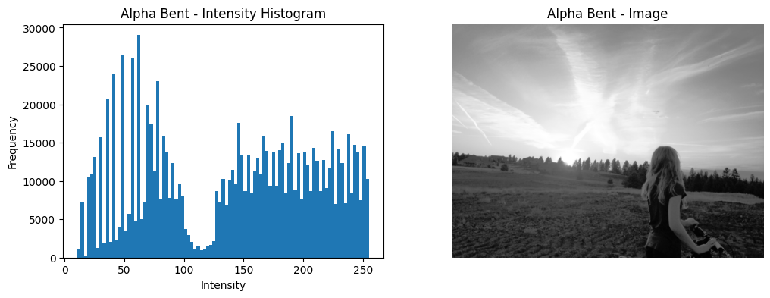
Proposed Method : Implementation
Histogram of the image
Enhanced image obtained by alpha blending
Image Processing - I
Indian Statistical Institute, Kolkata
13

Slide 14
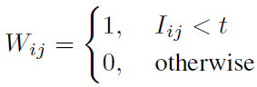
Proposed Method : Implementation
Otsu’s Method : It is used to divide the intensity image into dark and bright parts.
Obtaining the ideal threshold value t which maximizes the optimization function:
ω_{b}ω_{w}(m_{b} - m_{w})²
where:
ω_{b} : Number of pixels belonging to black class
ω_{w} : Number of pixels belonging to white class
m_{b} : Mean of pixels belonging to black class
m_{w} : Mean of pixels belonging to white class
Using this threshold t, a binary image W is generated:
Image Processing - I
Indian Statistical Institute, Kolkata
14

Slide 15
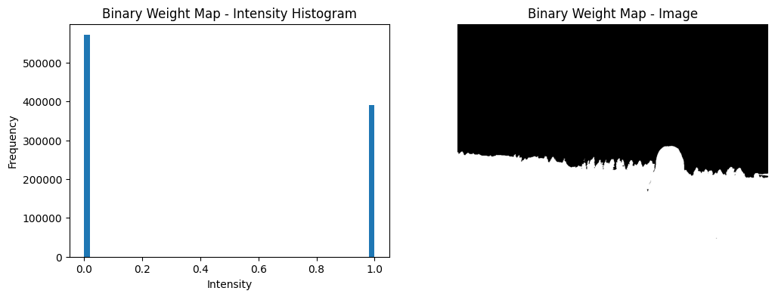
Proposed Method : Implementation
Histogram of the image
Binary weight map obtained from Otsu’s Method
Image Processing - I
Indian Statistical Institute, Kolkata
15

Slide 16
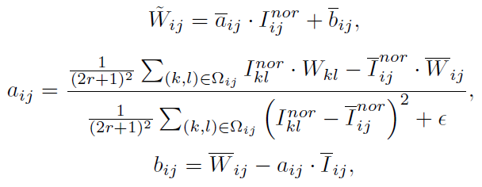
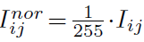
Proposed Method : Implementation
Guided Filter : Otsu’s method determines the threshold value from the histogram distribution of the entire image and does not consider the local bright-dark pattern. To resolve this, a guided filter is applied to the weight map with I as a guide image.
where, Ω_{ij} is a (2r+1)×(2r+1) square region centered at (i, j) (r = 1)
Image Processing - I
Indian Statistical Institute, Kolkata
16

Slide 17
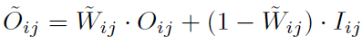
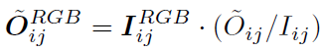
Proposed Method : Implementation
Image Composition using filtered weight map : Using W̃, the final intensity image Õ is composed by the following equation:
Then Õ is colorized by the following equation:
Image Processing - I
Indian Statistical Institute, Kolkata
17

Slide 18
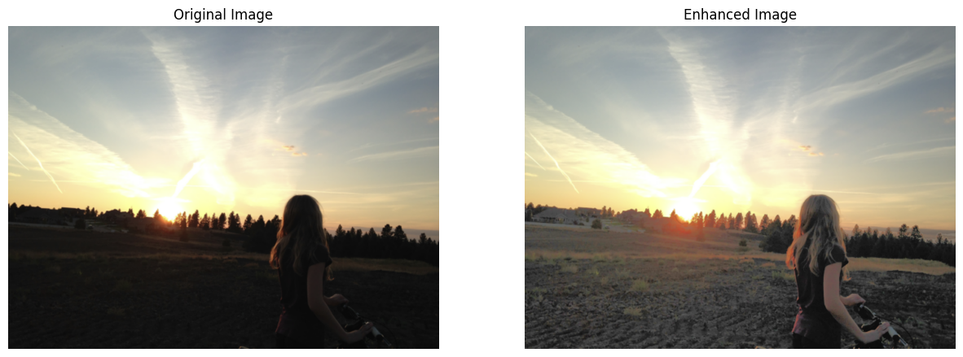
Proposed Method : Implementation
Original Backlit Image
Enhanced Image using the proposed method
Image Processing - I
Indian Statistical Institute, Kolkata
18

Slide 19
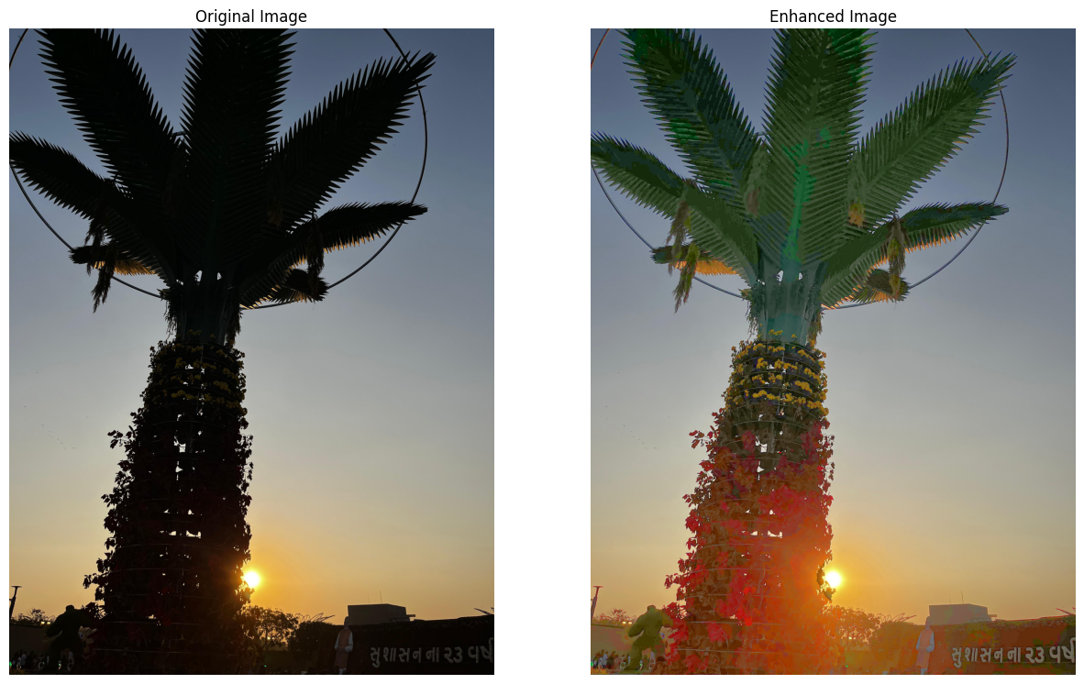
Implementation on Set of Backlit Images
Image Processing - I
Indian Statistical Institute, Kolkata
19

Slide 20
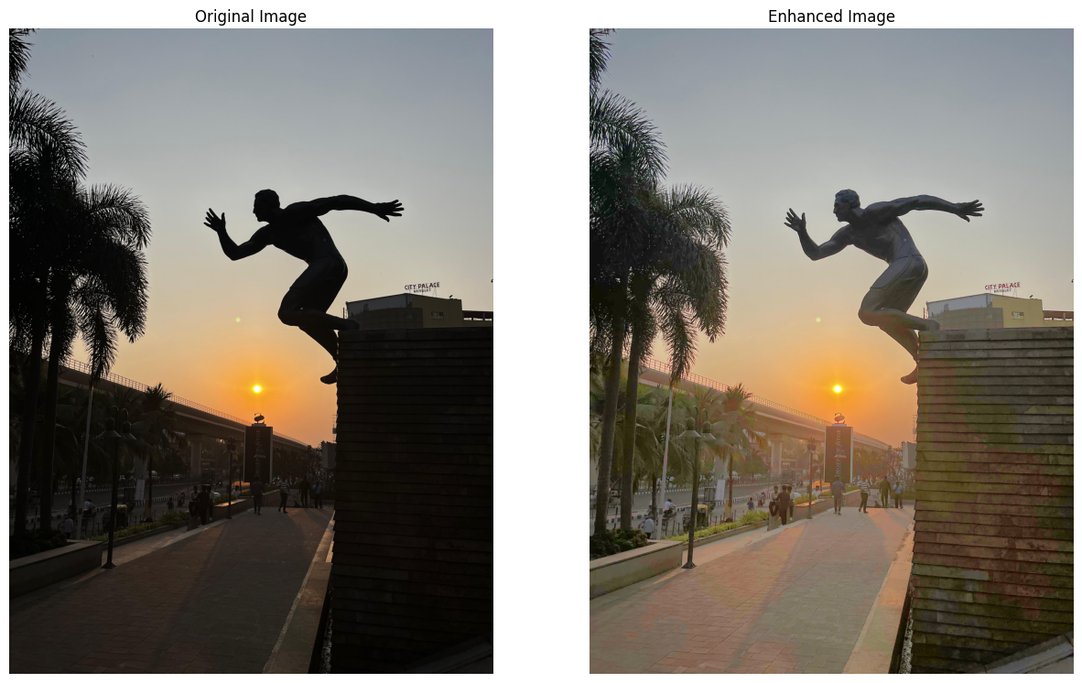
Implementation on Set of Backlit Images
Image Processing - I
Indian Statistical Institute, Kolkata
20

Slide 21
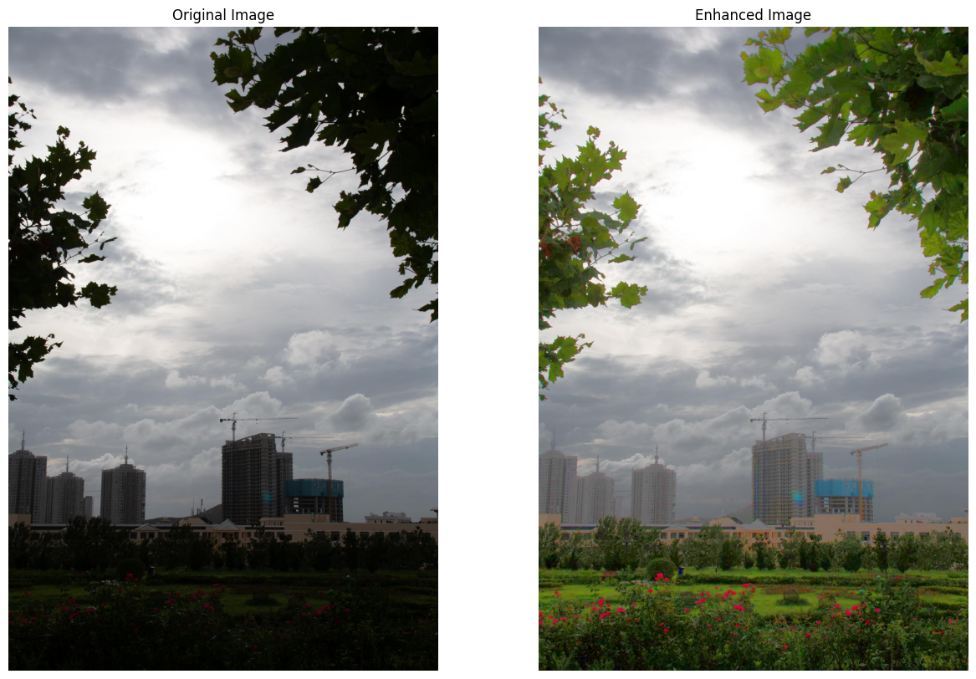
Implementation on Set of Backlit Images
Image Processing - I
Indian Statistical Institute, Kolkata
21

Slide 22
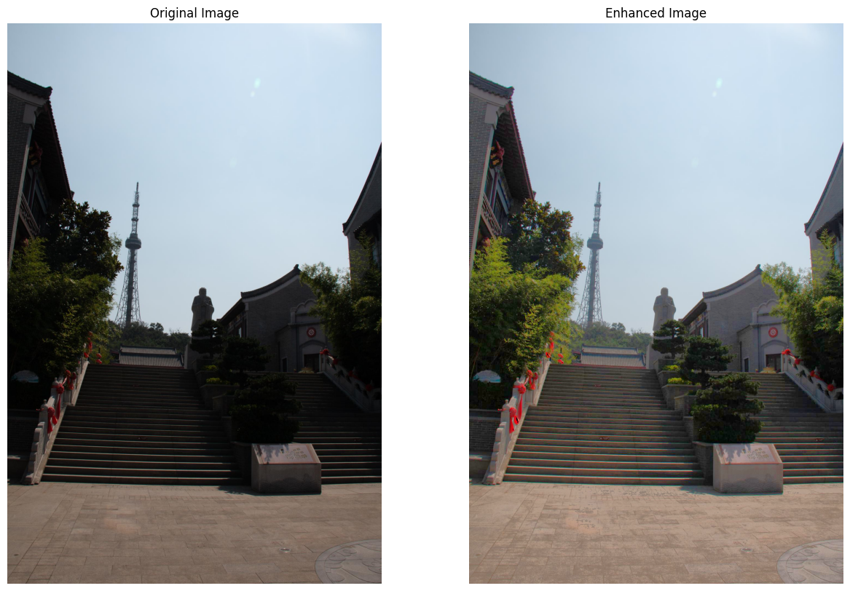
Implementation on Set of Backlit Images
Image Processing - I
Indian Statistical Institute, Kolkata
22

Slide 23
Proposed Algorithm vs Other Methods
The proposed algorithm is compared with Histogram Equalization (HE), Contrast Limited Adaptive Histogram Equalization (CLAHE) and Multiscale Retinex with Color Restoration (MSRCR).
For comprehensive evaluation the following metrics have been used:
LOE (Lightness Order Error): Measures the change in lightness order, lower LOE means better preservation
Q Value: Assesses image quality, calculated separately for dark and bright regions using the binary image
NIQE (Naturalness Image Quality Evaluator): A no-reference metric, lower scores indicate better quality
Image Processing - I
Indian Statistical Institute, Kolkata
23

Slide 24
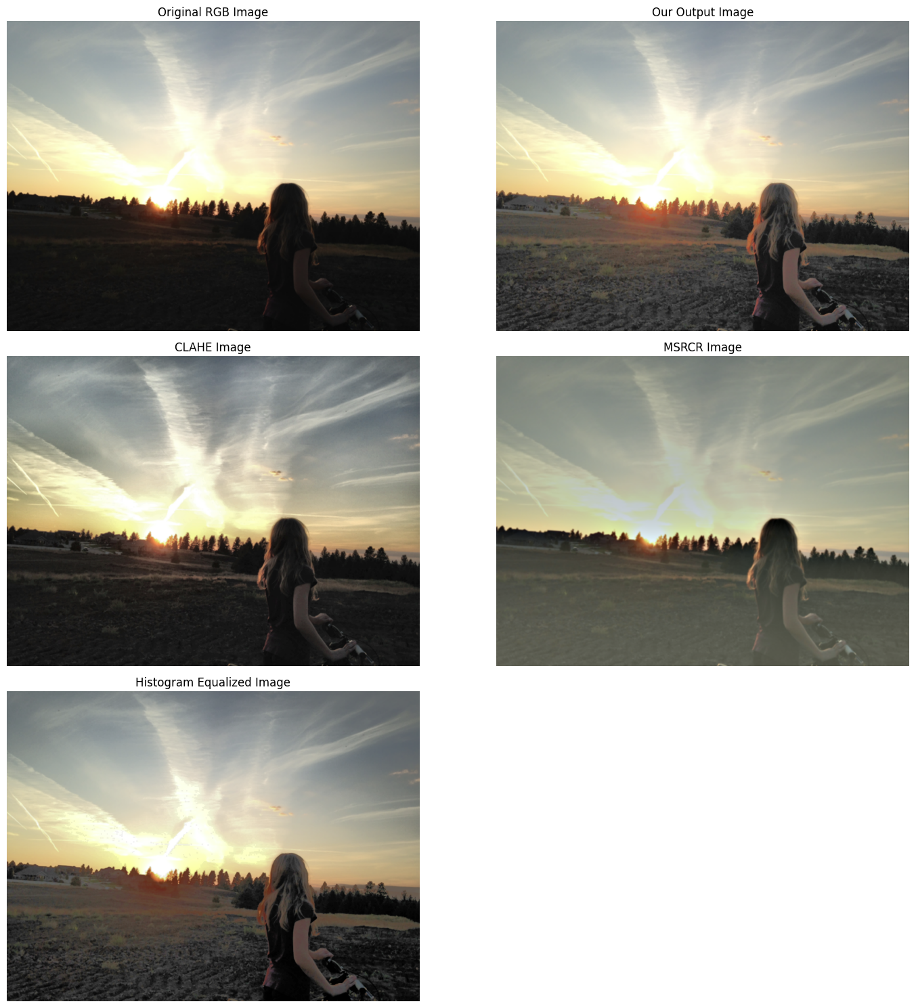
Proposed Algorithm vs Other Methods
Image Processing - I
Indian Statistical Institute, Kolkata
24

Slide 25
Proposed Algorithm vs Other Methods
Image Processing - I
Indian Statistical Institute, Kolkata
25

Slide 26
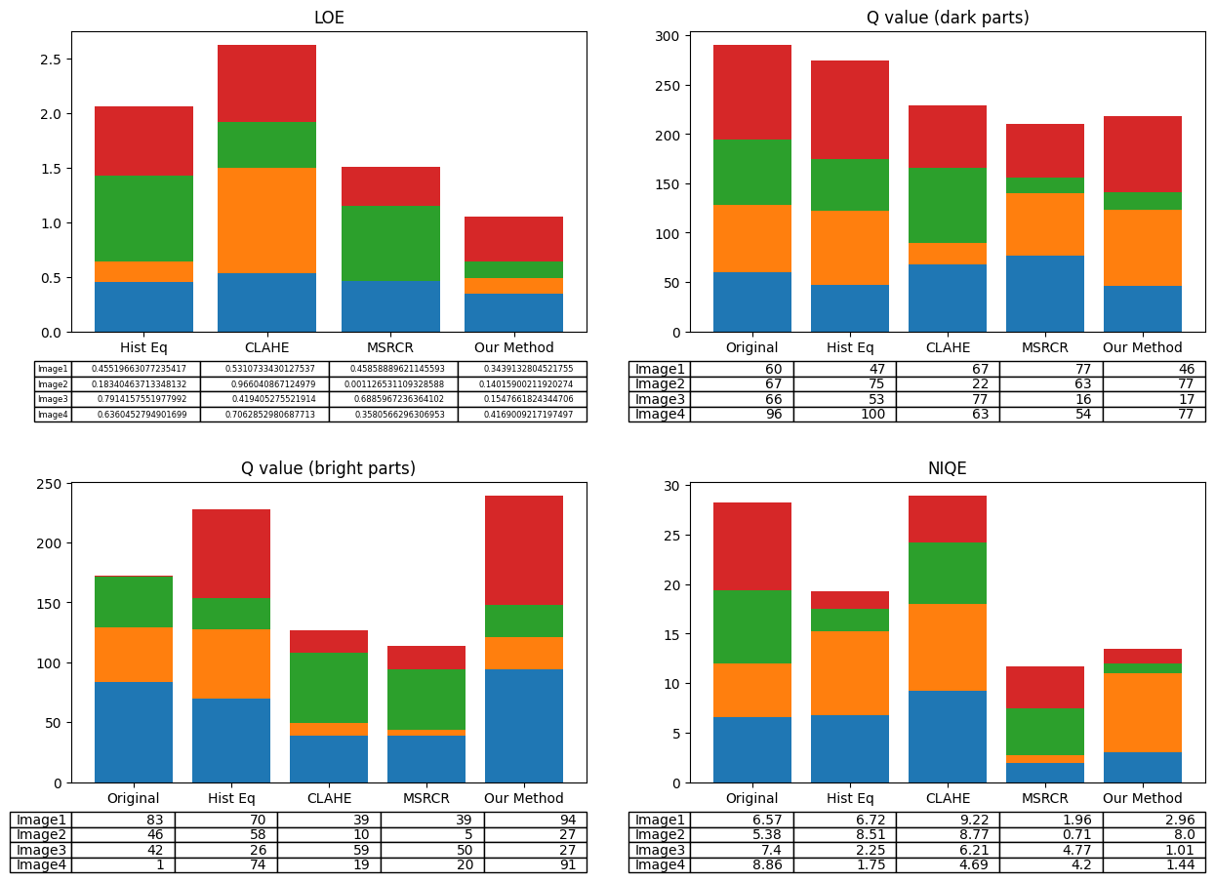
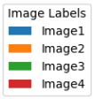
Proposed Algorithm vs Other Methods
Image Processing - I
Indian Statistical Institute, Kolkata
26

Slide 27
Proposed Algorithm vs Other Methods
Image Processing - I
Indian Statistical Institute, Kolkata
27

Slide 28
Conclusion
The proposed method consistently achieves lower LOE scores across all test images, indicating better preservation of intensity structure.
It delivers superior Q values for dark regions in Image 2 and bright regions in Images 1 and 4, showcasing balanced enhancement.
NIQE results demonstrate that the method outperforms both HE and CLAHE in perceptual quality for all images.
Overall, the method effectively enhances the visibility of dark areas while minimizing artifacts, ensuring visually pleasing results.
Image Processing - I
Indian Statistical Institute, Kolkata
28

Slide 29
References
A Single Backlit Image Enhancement Method For Improvement Of Visibility Of Dark Part (Published in: 2021 IEEE International Conference on Image Processing (ICIP)) : https://ieeexplore.ieee.org/document/9506526
BacklitNet: A dataset and network for backlit image enhancement : https://www.sciencedirect.com/science/article/pii/S1077314222000340
Image Processing: The Fundamentals - Maria Petrou, Costas Petrou
Digital Image Processing - Rafael C. Gonzalez, Richard E. Woods
Digital Picture Processing - Azriel Rosenfeld, Avinash C. Kak
Image Processing - I
Indian Statistical Institute, Kolkata
29

